Slide 1
Drowsiness Detection System

Slide 2
Introduction:
•Driver drowsiness detection is a car safety technology which helps prevent accidents caused by the driver getting drowsy.
• Various studies have suggested that around 20% of all road accidents are fatigue-related, up to 50% on certain roads.
•Nowadays the driver safety in the car is one of the most wanted system to avoid accidents.
•Our objective of the project is to ensure the safety system.
•For enhancing the safety, we are detecting the eye blinks of the driver and estimating the driver status and control the car accordingly.

Slide 3
Abstract:
The main idea behind this project is to develop a nonintrusive system which can detect fatigue of any human and can issue a timely warning. Drivers who do not take regular breaks when driving long distances run a high risk of becoming drowsy a state which they often fail to recognize early enough
This system will monitor the driver eyes using a camera and by developing an algorithm we can detect symptoms of driver fatigue early enough to avoid the person from sleeping. So, this project will be helpful in detecting driver fatigue in advance and will give warning output in form of alarm and pop-ups.

Slide 4
MOTIVATION
Now-a-days, there is a huge increase in private transportation in this modernized world.
Driving for long hours and distance can be a tedious task and boring for drivers.
One of the main causes behind the driver’s lack of alertness is due to the excessive travelling without any sleep or rest.
Tired driver can tend to get drowsy while driving.
In every fraction of a second, drowsiness can turn into dangerous and life- threatening accidents that may even lead to death.

Slide 5
PURPOSE
To prevent those types of incidents, it is vital to monitor the driver’s alertness level continuously.
If the machine detects drowsiness, the driver should be alerted. Through this system, we can reduce accidents and save lives of a lot of people.
This system will monitor the driver’s eyes using a camera and by developing an algorithm we can detect symptoms of driver fatigue early enough to avoid the person from sleeping.

Slide 6
PROPOSED METHODOLOGY:
In the project, the main focus will be based on:
Concept of drowsiness detection system.
Determine drowsiness from these parameters: a)eye open . b) Eye Close.
This will increase the accuracy of drowsiness detection, leading to better assessment of attentiveness of drivers while driving.
We will use transfer learning for this model.

Slide 7
Literature Survey:
Reference No | Title | Year | Methodology | Tools | Achievements | Limitations/ Suggestions
1. | A Real-time Driving Drowsiness Detection Algorithm With Individual Differences Consideration | 2019 | This paper proposes a real-time driving drowsiness detection algorithm that considers the individual differences of driver. A deep cascaded convolutional neural network was constructed to detect the face region | Dlib toolkit - for detecting the face region. CNN, SVM | Achieved accuracy of 84% | Input was taken in such a way that almost all cases were taken during day time i.e when driver was not drowsy.

Slide 8
Literature Survey:
Reference No | Title | Year | Methodology | Tools | Achievements | Limitations/ Suggestions
2 | Driver Drowsiness Detection Using Face Expression Recognition | 2011 | Used sensors to detect the drivers drowsiness. | capacitive sensors | Accuracy achieved may be high | Involves lot of hardware components Also it is very uncomfortable for the drivers.

Slide 9
Literature Survey:
Reference No | Title | Year | Methodology | Tools | Achievements | Limitations/ Suggestions
3. | Driver Drowsiness Detection Using Condition-Adaptive Representation Learning Framework | 2018 | Representation learning, adaptive learning, convolutional neural network | Keras | Accuracy is 76% | Accuracy is low.

Slide 10
Literature Survey:
Reference No | Title | Year | Methodology | Tools | Achievements | Limitations/ Suggestions
4. | A Smartphone-Based Drowsiness Detection and Warning System for Automotive Drivers | 2018 | Proposed a 3 stage drowsiness detection system 1.uses the percentage of eyelid closure (PERCLOS) 2.second step uses the voiced to the unvoiced ratio obtained from the speech data from the microphone 3.verification stage | PERCLOS computation algorithm | Accuracy is 85% | This methodology takes lot of time.

Slide 11
Literature Survey:
Reference No 5. | Title Drowsiness Detection System based on Eye-closure using A Low-Cost EMG and ESP8266 | Year 2017 | Methodology prototype of drowsiness detection on the driver using a low-cost EMG, called Myoware, which can be used to detect the closure of the eyelid without injuring the eyes, by simply attaching it to the skin around the eyelid. | Tools Low-cost EMG ESP8266 | Achievements The use of closed eye duration indicator has a faster detection, because the results are quickly known so that it can give early warning more quickly when the driver is sleepy. | Limitations/ Suggestions The weakness of this prototype is that the monitoring cannot run in real time

Slide 12
Literature Survey:
Reference No 6. | Title Sleepy Eye's Recognition for Drowsiness Detection | Year 2013 | Methodology A cascaded Adaboost classifier with the Haar-like features is utilized to find out the face region. Second, the eyes region is located by ASM search algorithm. Then the binary pattern and edge detection are adopted to extract the eyes feature and determine the eye’s state | Tools A cascaded Adaboost classifier with the Haar-like features Active Shape Model (ASM) | Achievements Experimental results prove that the proposed method could accurately detect the sleepy eyes. and performance shows that the proposed recognition system without the training stage is useful for driver’s drowsiness detection. | Limitations/ Suggestions No training of data and less accuracy is expected

Slide 13
Literature Survey:
Reference No 7. | Title Design of Drowsiness, Heart Beat Detection System and Alertness Indicator for Driver Safety | Year 2016 | Methodology )In this method, electrodes are placed on the human body to receive EOG of EEG signals generated due to eye blinking. EOG signal is separated from EEG usingDiscrete Wavelet Transform. By setting a threshold value for coefficients, the eye blink rate can be found. | Tools MATLAB R-peak detection algorithm Image processing toolbox Computer vision cascade toolbox | Achievements Not only drowsiness of driver it also takes heartbeat of driver as an input | Limitations/ Suggestions It includes physical work as connecting electrodes to the driver.

Slide 14
Literature Survey:
Reference No 8. | Title Detection of Drowsiness from Facial Images in Real-Time Video Media using Nvidia Jetson Nano | Year 2020 | Methodology The input part consists of webcam camera for detecting face structure, whereas the process part has Nvidia Jetson Nano as a main equipment to evaluate by using Ubuntu operating system and using Python Conducting OpenCV library has facial landmarks | Tools Nvidia Nano Jetson. Nvidia Jetson Nano is a tool that accurately evaluates image by tracking closing eye motions more than 35 FPS or 1.5 seconds, | Achievements Algorithm can be used when a face is covered some parts except eyes and mouth, which does not affect the accuracy of the detection. | Limitations/ Suggestions Infrared camera is difficult to be found. Without this kind of camera, it is hard to detect face motions in dark places or less light accurately.

Slide 15
Literature Survey:
Reference No 9. | Title THE SMART AUTOMOBILE (SAM): An Application Based on Drowsiness Detection, Alcohol Detection, Vital Sign Monitoring and Lane based Auto Drive to avoid Accidents | Year 2020 | Methodology Camera Placement and Initialization Capturing Video Frames Face Detection Eye Extraction Determining the EAR Algorithm for determining EAR Determining the Drowsy state of the driver based on EAR: | Tools Raspbian Operating System openCV Python Dlib library | Achievements Not only it detects drowsiness but it also monitors vital signs | Limitations/ Suggestions

Slide 16
Literature Survey:
Reference No 10. | Title Drowsiness Detection using Photoplethysmography Signal | Year 2014 | Methodology make use of the PRV signal obtained from the PPG signal. Noise Removal Wavelet denoising Squaring | Tools Acquisition of signal using DAQ PPG technique | Achievements peak detection algorithm works with an accuracy of almost 100% | Limitations/ Suggestions It becomes hard to carry and maintain physical things like ppg and electrodes

Slide 17
Limitations Identified:
Although there are many working models are there for drowsiness detection system which consider video implementation.
We are going to use video implementation in this model.
There were also such models which made use of physical things like PPG and electrodes for detection which was not easy to carry along with us.

Slide 18
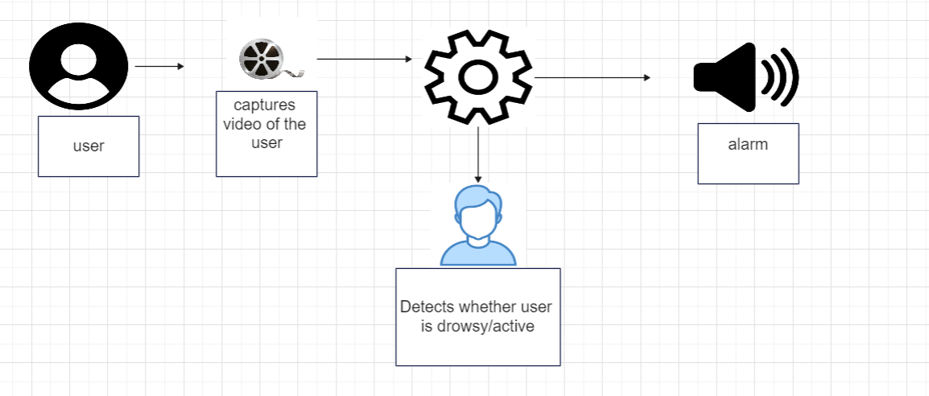
Architecture

Slide 19
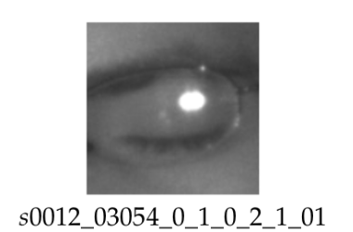
MRL eye dataset
In the dataset, they annotated the following properties (the properties are indicated in the following order):
subject ID; in the dataset, they collected the data of 37 different persons (33 men and 4 women)
image ID; the dataset consists of 84,898 images
gender [0 - man, 1 - woman]; the dataset contains the information about gender for each image (man, woman)
glasses [0 - no, 1 - yes]; the information if the eye image contains glasses is also provided for each image (with and without the glasses)
eye state [0 - closed, 1 - open]; this property contains the information about two eye states (open, close)
reflections [0 - none, 1 - small, 2 - big]; we annotated three reflection states based on the size of reflections (none, small, and big reflections)
lighting conditions [0 - bad, 1 - good]; each image has two states (bad, good) based on the amount of light during capturing the videos
sensor ID [01 - RealSense, 02 - IDS, 03 - Aptina]; at this moment, the dataset contains the images captured by three different sensors (Intel RealSense RS 300 sensor with 640 x 480 resolution, IDS Imaging sensor with 1280 x 1024 resolution, and Aptina sensor with 752 x 480 resolution)

Slide 20
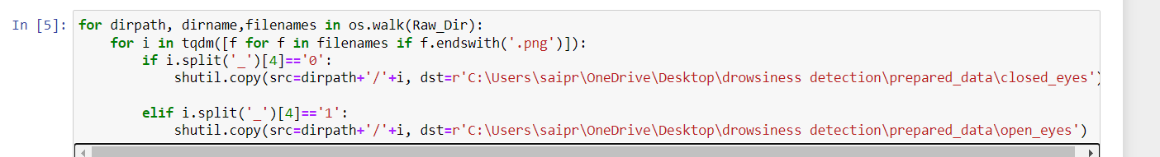
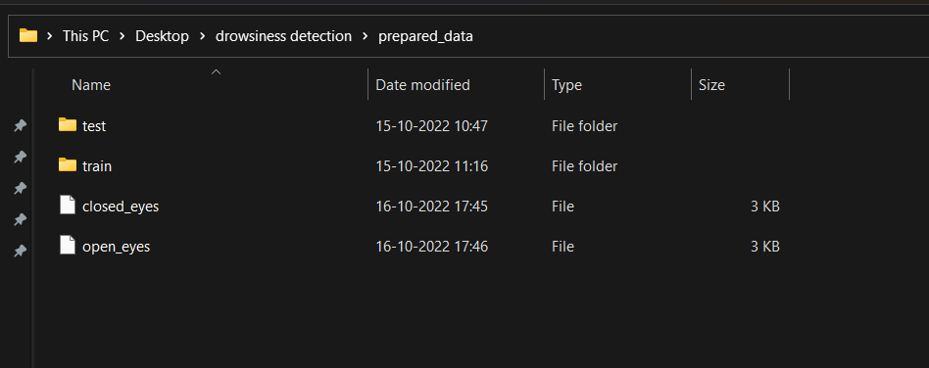

Slide 21
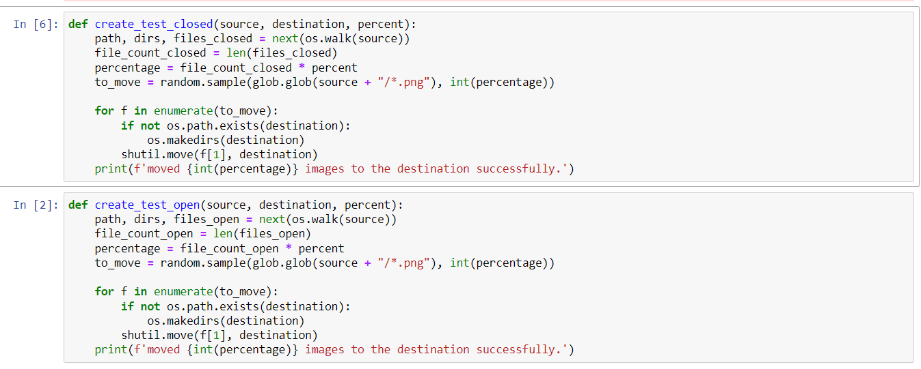


Slide 22
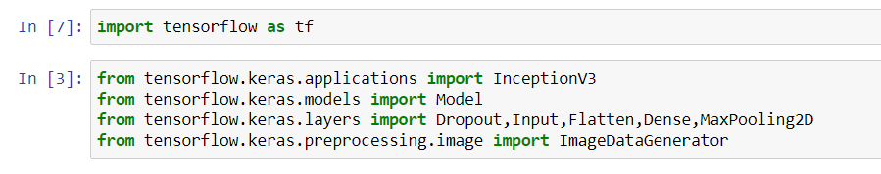
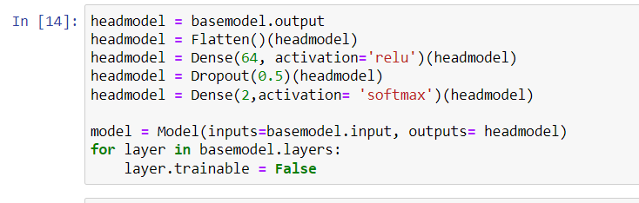
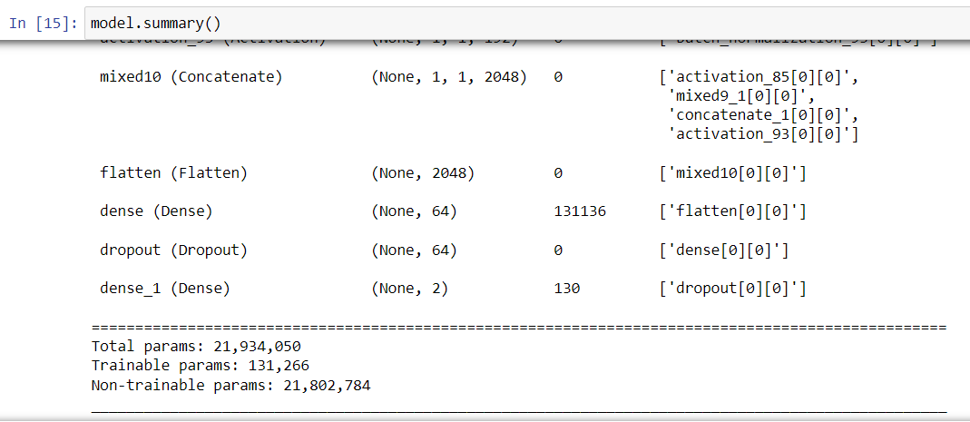
Model building

Slide 23
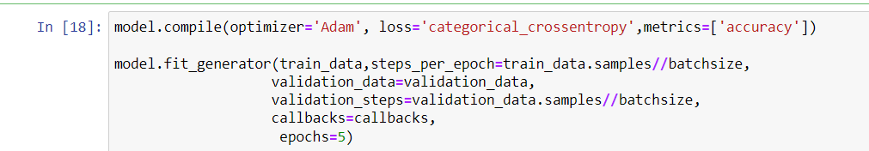
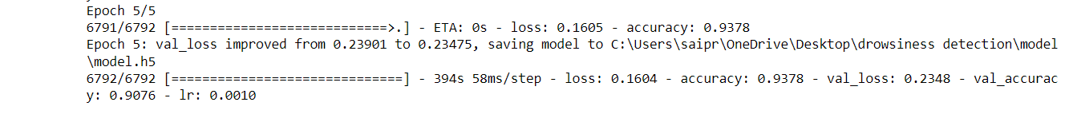
Model training

Slide 24
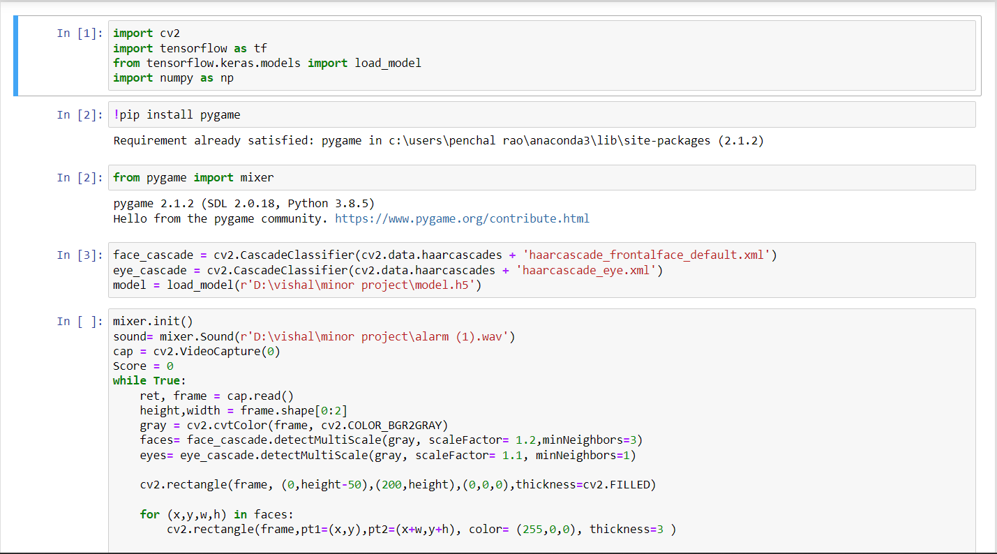

Slide 25
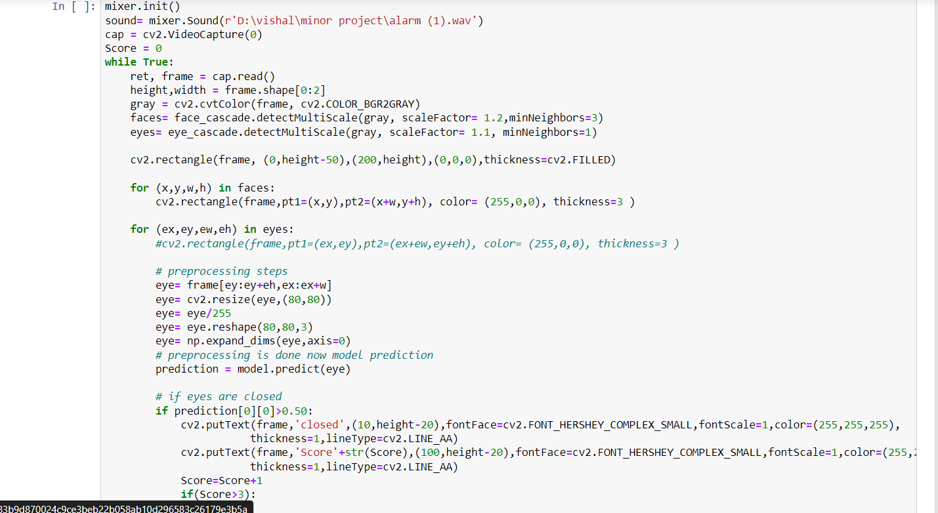

Slide 27
Module Description
Importing the dataset:
The dataset has been taken from
http://mrl.cs.vsb.cz/eyedataset
Working with dataset:
Visualizing and dividing dataset randomly into validation and training data.

Slide 28
Module Description
3. Model Building:
Now we will build our model, we start with the initialization of the model and adding different convents layers with ReLu as an activation function etc. to do learning efficiently.
4.Fitting model with Data:
After building the model we will fit the dataset with the model.

Slide 29
References:
[1] [ Ajay Verma, Sergio Cabrera, Allan Mayorga, and Homer Nazeran] “A Robust Algorithm for Derivation of Heart Rate Variability Spectra from ECG and PPG Signals,” in in 29th Southern Biomedical Engineering Conference
[2] [S. Mohamed Yacin1, M. Manivannan2, and V. Srinivasa Chakravarthy3] “Effect of Gastric Myoelectric Activity on Photoplethysmographic Signals” in International Journal of Recent Trends in Engineering Vol. 2, No. 1, Nov 2009
[3] [Vanisree K, Jyothi Singaraju] “Automatic Detection of ECG R-R Interval using Discrete Wavelet Transformation” in International Journal on Computer Science and Engineering (IJCSE)

Slide 30
References:
[5] K. Vengatesan, A. Kumar, V. Karuppuchamy, R. Shaktivel and A. Singhal, "Face Recognition of Identical Twins Based On Support Vector Machine Classifier," 2019 Third International conference on I-SMAC (IoT in Social, Mobile, Analytics and Cloud), Palladam, India, 2019, pp. 577-580, doi: 10.1109/ISMAC47947.2019.9032548.
[6] P. K. Kavitha and P. V. Saraswathi, "An Efficient Image Retrieval Using Fuzzy Based Clustering," Third International conference on ISMAC (IoT in Social, Mobile, Analytics and Cloud), P alladam, India, 2019, pp. 551-555, doi: 10.1109/ISMAC47947.2019.9032517

Slide 31
References:
[7] I Isabelle Tang and Toby P.Breckon., “Automatic Road Environment Classification,” IEEE Transactions on Intelligent Transportation Systems, vol. 12, no. 2, pp. 476-484, June 2011
[8] P. Jansen, W. van der Mark, J. C. van den Heuvel, and F. C. A. Groen , “Colour based off-road environment and terrin type classification,” Proceedings of the 8th International IEEE Conference on Intelligent Transportation Systems, pp. 216–221,2005.
[9] Inho Choi, Seungchul Han, and Daijin Kim, “Eye Detection and Eye Blink Detection using Adaboost Learning and Grouping,” Proceedings of the 20th International Conference on ICCCN, 2012.
[10] Xue Liu, Xiaoyang Tan, and Songcan Chen, “ Eye Closeness Detection Using Appearance Based Methods,” Intelligent Information Processing, volume 385 of IFIP Advances in Information and Communication Technology, pp. 398-408, 2012.

